Slide 1
Assessing COVID19: The Legal Horizon
IAAO – Maine Chapter Meeting
N. Joel Moser, Esq., M.G.A.
Bernstein Shur

Slide 2
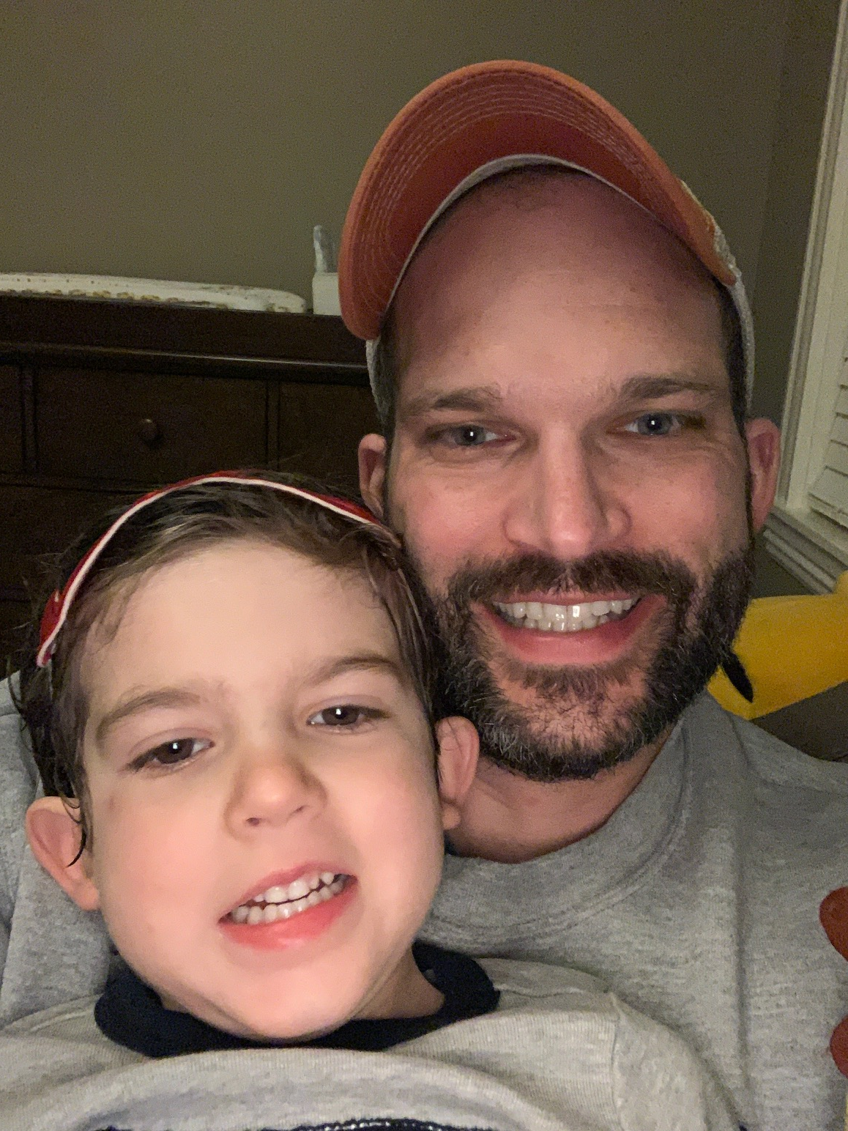
N. Joel Moser
Lawyer,
M.G.A.,
Caretaker-in-Chief of Toddlers

Slide 3
Bernstein Shur

Slide 4
Standard Legal Disclaimer
We cannot provide specific legal advice. We are providing general information only, and the information contained herein should not be relied upon without first consulting with a licensed attorney.
Bernstein Shur’s Coronavirus Response Team: https://www.bernsteinshur.com/what/practices-and-industries-served/municipal-governmental-services-supplemental/

Slide 5
Outline
The world has changed. Throw out the playbook.
The world is the same. We’ve been here before.
Practical Considerations: Tax Situs Dates, Deadlines, Court Closures, Contracts.
Processing Property Tax Cases in a Virtual World.
Transition to Remote Work: Legal Considerations.

Slide 6
Thoughts…
“Do the best possible job under the circumstances that currently exist.”
“You are not working from home. You are at home, during a crisis, trying to work.”
“Now, more than ever, be kind to one another.”

Slide 7
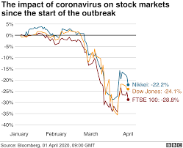
The world has changed. Throw out the playbook.
The $2.2 trillion CARES Act - Biggest fiscal stimulus package in American history.
Unemployment claims are at an all-time high.
No longer legally permissible businesses?
Commercial buildings – affect on NOI?
Residential foreclosure tidal wave coming?
Schools closed through end of year.
Governments operating remotely.
Restaurants, hotels, malls, spas, gyms, event spaces/concert venues, airlines – closed indefinitely.

Slide 8
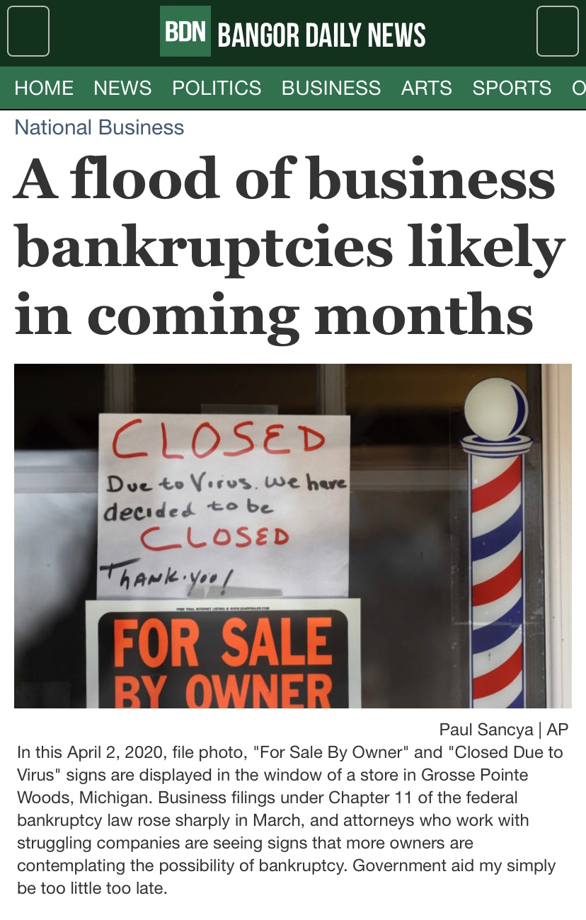
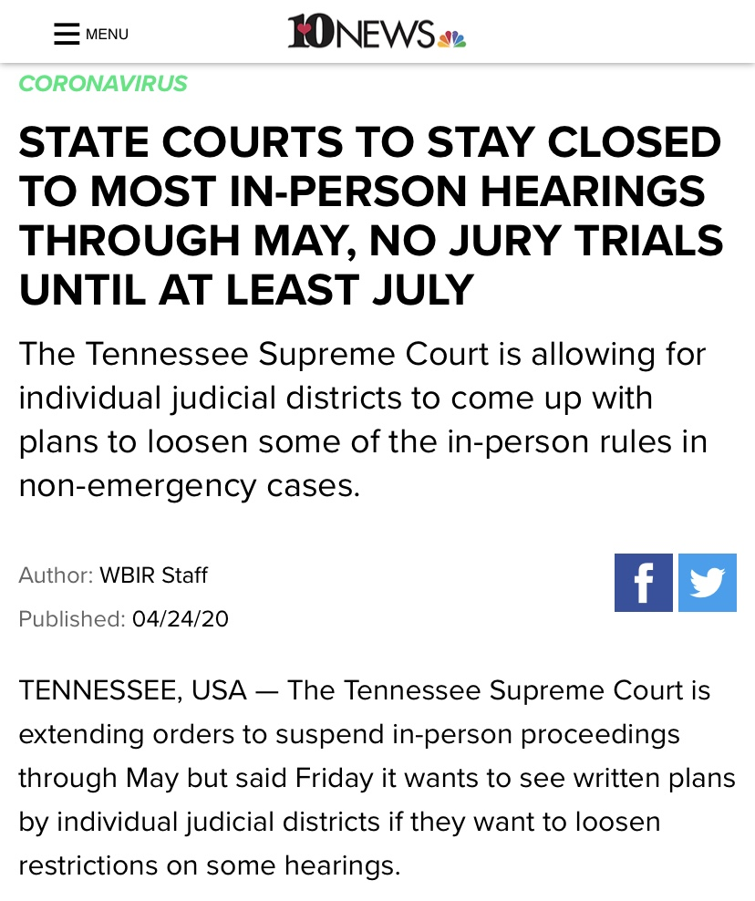
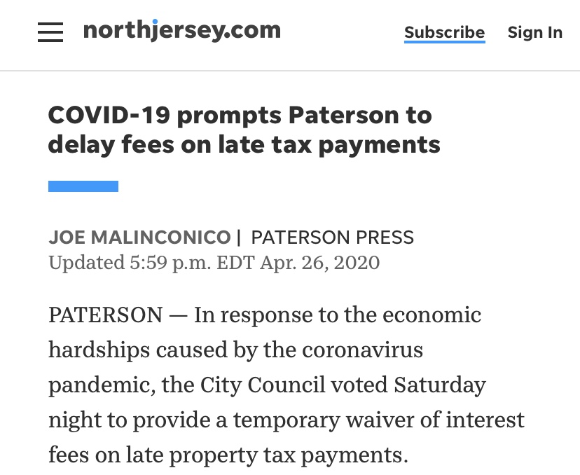
The world has changed. Throw out the playbook.

Slide 9
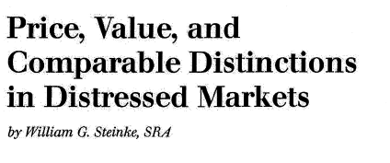
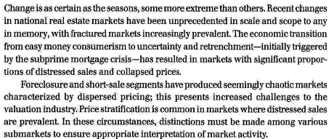
The world is the same. We’ve been here before.
Recent Recessions: mid 1970s, early 1980s, the Great Recession in 2007-2009: decline in assessed value of property lags a little behind.

Slide 10
The world is the same. Lessons from Maine Case Law.
Sweet v. City of Auburn, 180 A. 803 (Me. 1935)
“Assessors are not, however, obliged to follow the fleeting, speculative fancy of the moment; they should recognize that the true value of a fixed asset, such as real estate, is fairly constant and must be gauged by conditions, not temporary and extraordinary, but by those which over a period of time will be regarded as measurably stable.” Id. at 804.
Town of Sanford v. J & N Sanford Trust, 694 A.2d 456 (Me. 1997)
“To allow business acumen to form the controlling basis of property tax assessment ... would obliterate the principal concept of consistency.” Id. at 461 (internal quotation omitted).
“Equitable treatment of similarly situated taxpayers must take primacy over rigid adherence to the willing buyer-willing seller analysis. See Kittery Electric Light Co., 219 A.2d at 734 (uniformity and equality is to be preferred as the just and ultimate purpose of the law when there is a conflict between fair market value and equality).” Id.

Slide 11
The world is the same. Lessons from Maine Case Law.
Frank v. Assessors of Skowhegan, 329 A.2d 167 (Me. 1974)
“It seems to us plaintiff, in effect, is saying that a willing purchaser will pay for income-producing property only that price which is justified by the income produced at or just prior to the time of purchase. Income from rental property is peculiarly subject to the influence of temporary general economic conditions. If we carry, what seems to be plaintiff's argument, to its logical conclusion, tax assessors would be required to down value income-producing property each time there is even a temporary economic decline.
We cannot accept this reasoning.
Stability in municipal income is a factor which must always be considered. To require owners of property which is not income-producing to pick up the deficiency resulting from reducing the tax burden of income property owners each time there is a temporary downward trend in the economy, would surely not be either feasible or equitable.” Id. at 175.

Slide 12
We’ve haven’t been here before, but there are lessons from the past.
Framework for assessing during disruptions is not unique – even at the macro level
Three approaches to value: Cost, Sales Comparison, and Income Approaches
Sales comparison approach considerations
Selection of comparable sales: distinctions required between distressed & non-distressed assets, short sales & foreclosures?
Buyer profile transition from owner/occupied to investor / speculator
Changes in highest and best use
Cost approach → economic obsolescence factors

Slide 13
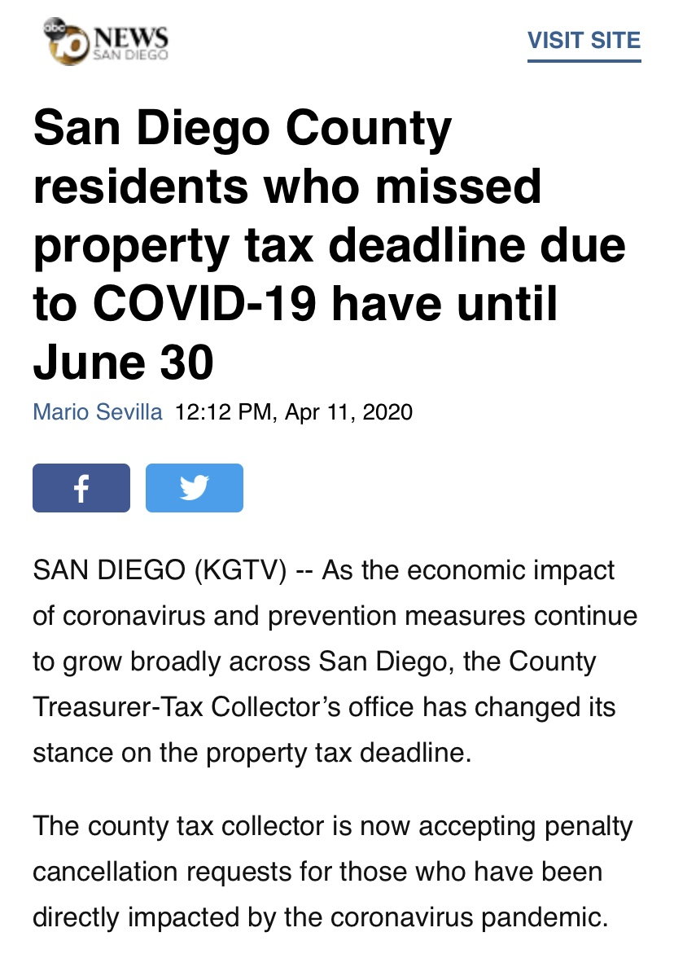
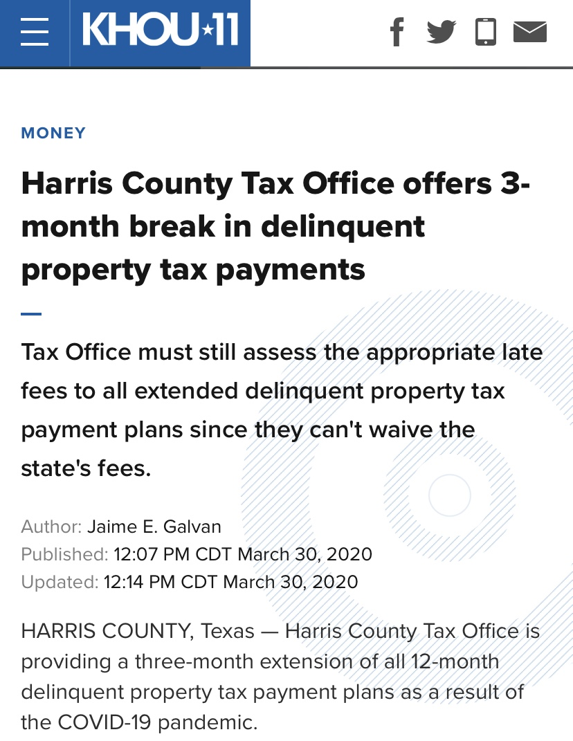
Practical Considerations: The Legal Horizon
“Unprecedented” here really is unprecedented.
The tax situs date is (maybe no longer) sacrosanct?
Deadlines are still deadlines... unless they are extended.
Court closures & (maybe) tolling deadlines.
Assessors vs. tax collectors: property tax relief programs
Be extremely thoughtful in municipal communications
Continuity of Government Plans

Slide 14
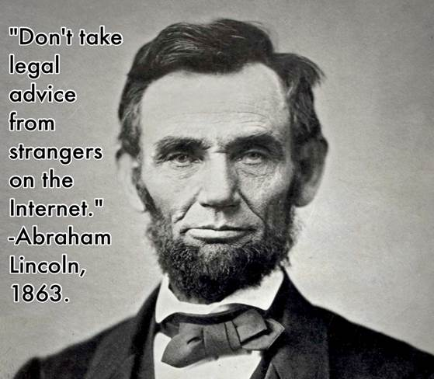
Practical Considerations: The Legal Horizon
Contracts:
Anticipate & Communicate
Contract/Legal Doctrines that may excuse performance (Force Majeure Clauses, doctrine of impossibility, doctrine of impracticability)
Governmental Procurement during COVID-19
Supply chain procurement plans, especially external experts/appraisers

Slide 15
This Will Ultimately Be Played Out in the Courts
We do not know yet the effect COVID-19 will have on property values.
We DO know that there will likely be many challenges to property assessments in the coming years.
Strong record, strong data, strong support.
Mediation & Dispute Resolution

Slide 16
Processing Property Tax Cases in a Virtual World
Public Meetings & Open Space Law
Zoom & Virtual Meetings
Watch out for “Zoom Bombing”
Buckle up for the virtual hearing
Court & State Government Closures: expect major delays
To a fault, appear reasonable…but don’t be afraid to respectfully call out bad behavior

Slide 17
Transition to Remote Work – Legal Considerations
Stay on top of deadlines (which may be changing and may not be tolling)
Technology & Data Security!
Keep taxpayer/client information safe when at home
Supervise and lead by staying in touch (and not just by email)
Keep track of time if needed for billing purposes
Remote notary & DocuSign
Slow down and get it right

Slide 18
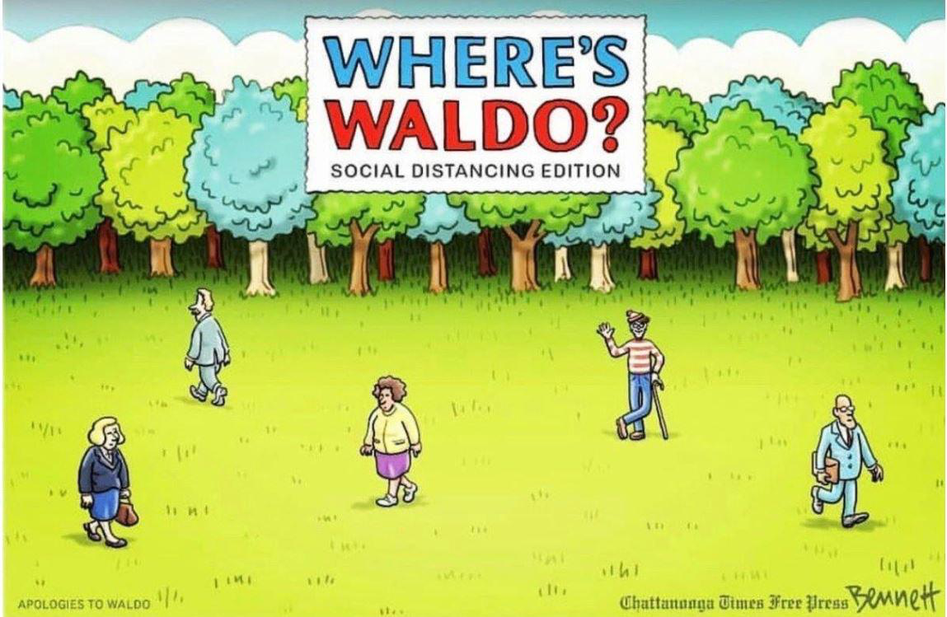
Concluding thought
“The water is a little bit high, but I think I will just go wiff it.” – Oscar Moser (4 years old)

